Slide 1

Smart Doc: AI Powered Medical Consultant with a Human Intellect to Support and Enhance People’s Lives in Emergencies
M. Aishwarya
RA1811003040117
4th year
CSE ‘D’

Slide 2
Abstract
Tech-based self-service channels and digital health interventions have the potential to support the patients in their everyday life and health professionals likewise. With the rise in artificial intelligence and innovation in digital technologies have paved the way for the medical systems to expand to meet the expectations of the people who need health care support especially during these kinds of unprecedented circumstances such as the hay fever, flu and other viral infections.
Although there are scalable self-service channels such as Alexa, Google Assistant, Siri, yet they cannot be applied in medical care settings due to their lack of domain knowledge. Hence this project presents a healthcare chatbot called ‘Smart Doc’ created using Artificial Intelligence that can have a significant impact on the lives of the people. This chatbot provides us with a human-system interaction with a user-friendly interface and it aims to solve the specific prerequisites of a person who need healthcare suggestions before visiting the hospital. The chatbot system works on the inputs provided by the user (patient) and answers it accordingly.

Slide 3
Applications
Diagnosis Based on Symptoms
Schedule Appointments

Slide 4
Software & Tools
Visual Studio Code
HTML
CSS
JavaScript
My SQL
Python

Slide 5
Modules
Input
Input from user
Analyze and process
Analyze and process user’s input
Identify
Identify the symptom
Compose
Compose Reply
Schedule and Manage
Schedule Appointments

Slide 6
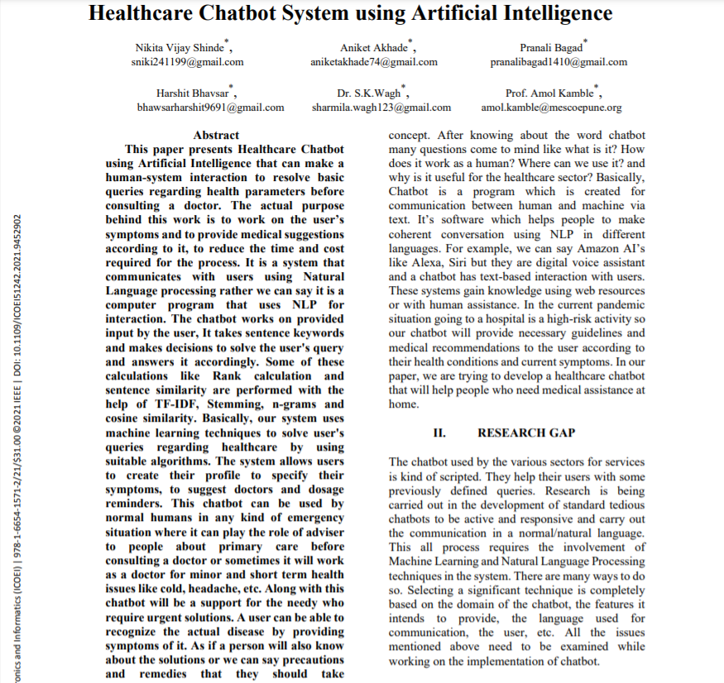
Base Paper Title
Healthcare Chatbot System using Artificial Intelligence

Slide 7
Thank you

